Slide 1
Portfolio Milestone
IST 782 | Applied Data Science Portfolio
Presenter | Ryan Tervo
Date | 09 June 2023

Slide 2
Overview
Introduction
Purpose
Projects
Summary

Slide 3
Introduction
The Syracuse University Applied Data Science program is designed to be a professional study with a strong emphasis on the applications of data science to enterprise operations and processes.
------------------------------------------------------------------------------------------------------------------
The Applied Data Science Program Has Six Learning Objectives
1. Use programming languages such as R and Python to support the generation of actionable insight
2. Apply visualization and predictive models to help generate actionable insight
3. Communicate insights gained via visualization and analytics to a broad range of audiences (including project sponsors and technical team leads
4. Collect, store, and access data by identifying and leveraging applicable technologies
5. Create actionable insight across a range of contexts (e.g. societal, business, political), using data and the full data science life cycle
6. Apply ethics in the development, use and evaluation of data and predictive models (e.g., fairness, bias, transparency, privacy)

Slide 4
Purpose
This presentation will demonstrate how the 6 Applied Data Science Learning Objectives were accomplished using examples from 3 course projects.
------------------------------------------------------------------------------------------------------------------
Courses Selected for Discussion and Review
IST 719: Information Visualization
IST 736: Text Mining
IST 772: Quantitative Reasoning for Data Science

Slide 5
IST 719 Info Visualization
Project Description:
Airline on-time trend flight analysis
Data Source:
Bureau of Transportation
Programming Language:
R

Slide 6
Project Details
Purpose:
Create a large professional poster which told a story in data.
Poster had to be visually appealing from “across the room” as well as close up.
Challenges:
Each graph on the poster had to be both visually pleasing individually and collectively.
Everything on the poster had work together
Poster elements had to support a theme without being distracting.

Slide 7
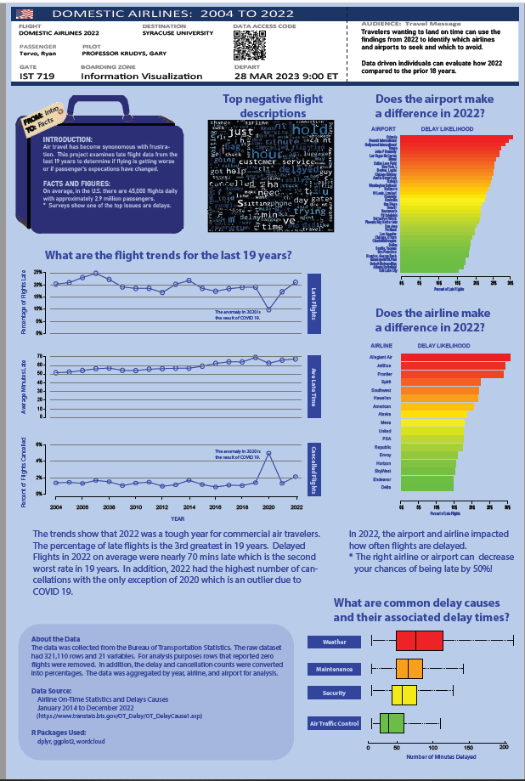
Project Results
Project Highlights
The overall poster board incorporated flight themes.
Six graphs were created and a word cloud.
A QR code was created for viewers to access the source data.
Applied Data Science Program Objectives Met
1. Use programming languages such as R and Python to support the generation of actionable insight
4. Collect, store, and access data by identifying and leveraging applicable technologies

Slide 8
IST 736 Text Mining
Project Description:
Sentiment analysis of air passenger tweets
Data Source:
Kaggle.com
Programming Language:
Python

Slide 9
Project Details
Purpose:
Sentiment analysis was conducted to identify negative air passenger tweets.
Using the identified negative tweets, topic analysis was performed to determine what passengers issues to determine trends
Challenges:
Several model configurations had to be investigated to identify the best method. These included using two machine learning algorithms (MNB - multinomial naïve bayes & SVM - support vector machine) and three vectorizers.
Selecting the correct metric to evaluate the algorithm performance was a bit of an art and science. In the project the accuracy, precision, recall, and F1-score were provided. In the end, the metric deemed most applicable was the F1-score as it is the harmonic mean between precision and recall.
Topic modeling was good but selecting the correct parameters was a bit of trial and error. The final parameter selection was based on human intuition and preference.

Slide 10
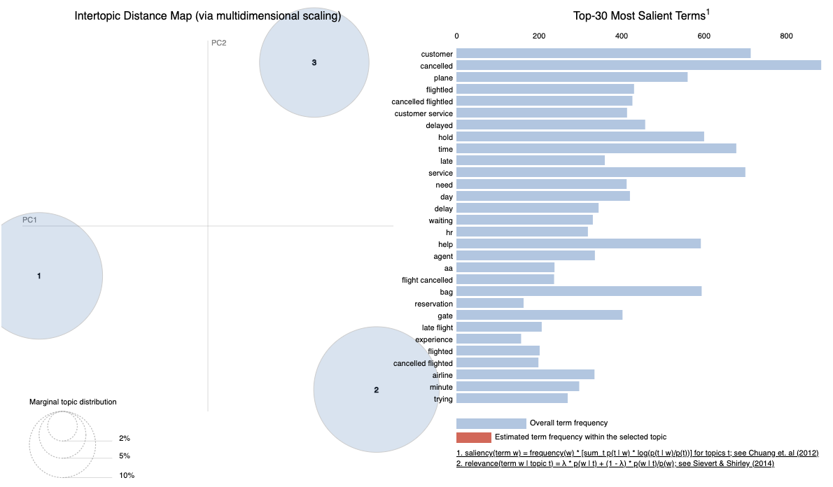
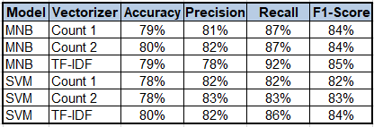
Project Results
Project Highlights
Asf asfd
Asdf asfd
Asdf afsd
Applied Data Science Program Objectives Met
1. Use programming languages such as R and Python to support the generation of actionable insights
2. Apply visualization and predictive models to help generate actionable insight
3. Communicate insights gained via visualization and analytics to a broad range of audiences (including project sponsors and technical team leads
5. Create actionable insight across a range of contexts (e.g. societal, business, political), using data and the full data science life cycle
Notes:
1. Use programming languages such as R and Python to support the generation of actionable insigh
2. Apply visualization and predictive models to help generate actionable insight
3. Communicate insights gained via visualization and analytics to a broad range of audiences (including project sponsors and technical team leads
4. Collect, store, and access data by identifying and leveraging applicable technologies
5. Create actionable insight across a range of contexts (e.g. societal, business, political), using data and the full data science life cycle
6. Apply ethics in the development, use and evaluation of data and predictive models (e.g., fairness, bias, transparency, privacy)

Slide 11
IST 772 Quantitative Reasoning for Data Science
Project Description:
Interpret results of statistical tests
Data Source:
Course Provided
Programming Language:
R

Slide 12
Project Details
Purpose:
Without having access to the underlying data, review and interpret the statistical results of a theoretical product that was evaluated.
Based on your interpretations of the statistical results, make a recommendation on the product’s next steps in R&D to a technical and non technical audience.
Challenges:
Not having access to the underlying data meant you really have to trust the test results and know how to read them correctly.
Communicating technical info to a non technical audience is not trivial.

Slide 13
Project Results
Project Highlights
This project required interpretation of statistical Frequentist and Bayesian tests.
Communicating to the technical minded group was considerable easier than to the non-tech.
The interpretation to the non tech group required care as to provide meaningful insights without relying on technical language.
Applied Data Science Program Objectives Met
3. Communicate insights gained via visualization and analytics to a broad range of audiences (including project sponsors and technical team leads
5. Create actionable insight across a range of contexts (e.g. societal, business, political), using data and the full data science life cycle
6. Apply ethics in the development, use and evaluation of data and predictive models (e.g., fairness, bias, transparency, privacy)
Notes:
1. Use programming languages such as R and Python to support the generation of actionable insight
2. Apply visualization and predictive models to help generate actionable insight
3. Communicate insights gained via visualization and analytics to a broad range of audiences (including project sponsors and technical team leads
4. Collect, store, and access data by identifying and leveraging applicable technologies
5. Create actionable insight across a range of contexts (e.g. societal, business, political), using data and the full data science life cycle
6. Apply ethics in the development, use and evaluation of data and predictive models (e.g., fairness, bias, transparency, privacy)

Slide 14
Summary
The three projects discussed have met six Learning Objectives in the
the Applied Data Science Program.
I’m truly grateful to have been a part of this school and program specifically.
To all of my course instructors & fellow students, thank you for a great experience.

Slide 15
Questions??

Slide 16
Thank You!!!

Slide 18
Program Objectives
The Applied Data Science Program has six Learning Objectives
1. Use programming languages such as R and Python to support the generation of actionable insight
2. Apply visualization and predictive models to help generate actionable insight
3. Communicate insights gained via visualization and analytics to a broad range of audiences (including project sponsors and technical team leads
4. Collect, store, and access data by identifying and leveraging applicable technologies
5. Create actionable insight across a range of contexts (e.g. societal, business, political), using data and the full data science life cycle
6. Apply ethics in the development, use and evaluation of data and predictive models (e.g., fairness, bias, transparency, privacy)

